Slide 1
Lecture 16
Signals and Systems (ELL205)
By Dr. Abhishek Dixit
Dept. of Electrical Engineering
IIT Delhi

Slide 2


Analysis and Synthesis equation
$$x\left(t\right)=x\left(t+T\right)=\sum_{k}{a_{k}e^{jkω_{o}t}}$$
Synthesis
$$ak=\frac{1}{T}\int_{T}{x\left(t\right)e^{−jkω_{o}t}dt}$$
Analysis

Slide 3
List of Properties
Signal | Coefficients
Real & Even | Real & Even
Real & Odd | Imaginary & Odd
Imaginary & Even | Imaginary & Even
Imaginary & Odd | Real & Odd
1.
$$x\left(t\right)↔ak$$
2.
$$x\left(−t\right)↔a_{−k}$$
3.
$$\overline{x\left(t\right)}↔\overline{a_{−k}}$$
4.
$$x\left(t−t_{o}\right)↔e^{−jkωoto }ak$$

Slide 4
List of Properties
Signal | Coefficients
Real & Even | Real & Even
Real & Odd | Imaginary & Odd
Imaginary & Even | Imaginary & Even
Imaginary & Odd | Real & Odd
Shifted signal | Only phase changes
1.
$$x\left(t\right)↔ak$$
2.
$$x\left(−t\right)↔a_{−k}$$
3.
$$\overline{x\left(t\right)}↔\overline{a_{−k}}$$
4.
$$x\left(t−t_{o}\right)↔e^{−jkωoto }ak$$

Slide 5


Use properties
$$a_{k}$$
--1.0 -0.5 -0.25 0 0.25 0.5 1
$$b_{k}=?$$
--1.0 -0.5 -0.25 0 0.25 0.5 1

Slide 6
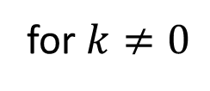


Use properties
$$a_{k}$$
--1.0 -0.5 -0.25 0 0.25 0.5 1
$$b_{k}=?$$
--1.0 -0.5 -0.25 0 0.25 0.5 1
$$b_{k}=a_{k}$$
for $k≠0$
$$b_{o}=0$$

Slide 7
Convergence of Fourier Series
$x\left(τ\right)$ square integrable,
If $\int_{T}{{\left|x(τ)\right|}^{2}dτ<∞}$Then $\int_{T}{{\left|e_{N}\left(t\right)\right|}^{2}dt→0}$ as $N→∞$
$$\lim_{N→∞}\left(\int_{T}{{\left|x\left(t\right)−\sum_{k=−N}^{N}{a_{k}e^{jkω_{o}t}}\right|}^{2}dt}\right){→0}$$
$$x\left(t\right)≜l.i.m\sum_{k=−∞}^{∞}{a_{k}e^{jkω_{o}t}}$$

Slide 8
Properties of FS
1. Linearity
$$x\left(t\right)↔ak$$
$$y\left(t\right)↔bk$$
If & then
α$x\left(t\right)+βy\left(t\right)↔\text{α}ak+βbk$

Slide 9
Properties of FS
1. Linearity
$$x\left(t\right)↔ak$$
$$y\left(t\right)↔bk$$
If & then
α$x\left(t\right)+βy\left(t\right)↔\text{α}ak+βbk$
Proof:
$$ck=\frac{1}{T}\int_{T}{\text{(}\text{α}x\left(t\right)+βy\left(t\right))e^{−jkω_{o}t}dt}$$
$$ck=\frac{α}{T}\int_{T}{x\left(t\right)e^{−jkω_{o}t}dt+\frac{β}{T}\int_{T}{y\left(t\right)e^{−jkω_{o}t}dt}}$$
$$ck=\text{α}ak+βbk$$

Slide 10

Properties of FS
2. Time-scaling
$$x\left(t\right)↔ak$$
$$x\left(αt\right)↔ak$$
If then
$$α∈ℝ+$$

Slide 11
Properties of FS
2. Time-scaling
$$x\left(t\right)↔ak$$
$$x\left(αt\right)↔ak$$
If then
$$α∈ℝ+$$
Proof:
$$bk=\frac{α}{T}\int_{T/α}{x\left(αt\right)e^{−jkαω_{o}t}}dt$$
Starting with def.
Substituting,
$$αt=λ$$
$$bk=\frac{1}{T}\int_{T}{x\left(λ\right)e^{−jkω_{o}λ}}dλ$$
we get,

Slide 12
Properties of FS
3. Flipping

Slide 13
Properties of FS
4. Differentiation
$$x\left(t\right)↔ak$$
$$\frac{dx\left(t\right)}{dt}↔{jkω_{o}a}_{k}$$
If then

Slide 14
Properties of FS
4. Differentiation
$$x\left(t\right)↔ak$$
$$\frac{dx\left(t\right)}{dt}↔{jkω_{o}a}_{k}$$
If then
Proof:
$$x\left(t\right)=\sum_{k}{a_{k}e^{jkω_{o}t}}$$
$$\frac{dx\left(t\right)}{dt}=\sum_{k}{{jkω_{o}a}_{k}e^{jkω_{o}t}}$$

Slide 15
Use properties
0.5
-1.0 -0.5 0 0.5 1
-0.5
How many of the following terms are correct?
1) Odd harmonics decreases as $k^{2}$ | 2) Even harmonics are zero
3) $a_{0}$ is 0 | 4) It requires a fewer terms for signal construction

Slide 16
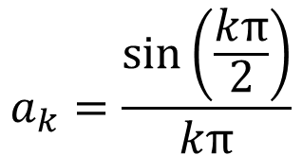

Step 1
$$a_{k}=\frac{sin⁡\left(\frac{kπ}{2}\right)}{kπ}$$
--1.0 -0.5 -0.25 0 0.25 0.5 1
$$a_{k}=\frac{\sin\left(\frac{kπ}{2}\right)}{kπ}$$
for $k≠0$
--1.0 -0.5 -0.25 0 0.25 0.5 1
$$a_{0}=0$$

Slide 17

Step 2
$$a_{k}=\frac{\sin\left(\frac{kπ}{2}\right)}{kπ}$$
--1.0 -0.5 -0.25 0 0.25 0.5 1
$$a_{0}=0$$
$$a_{k}=\frac{\sin\left(\frac{kπ}{2}\right)e^{−jkπ/2}}{kπ}$$
$$a_{0}=0$$
--1.0 -0.5 -0.25 0 0.25 0.5 1
$$a_{k}=\left\{\begin{aligned}\frac{1}{jkπ} k odd \\ 0 k even\end{aligned}\right.$$

Slide 18
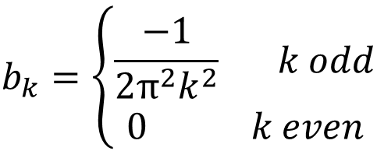
Step 3
$$a_{k}=\left\{\begin{aligned}\frac{1}{jkπ} k odd \\ 0 k even\end{aligned}\right.$$
--1.0 -0.5 -0.25 0 0.25 0.5 1
$$b_{k}=\left\{\begin{aligned}\frac{−1}{2π^{2}k^{2}} k odd \\ 0 k even\end{aligned}\right.$$
--1.0 -0.5 -0.25 0 0.25 0.5 1

Slide 19
Use properties
0.5
-0.5
--1.0 -0.5 0 0.5 1
How many of the following terms are correct?
1) Odd harmonics decreases as $k^{2}$ | 2) Even harmonics are zero
3) $a_{0}$ is 0 | 4) It requires a fewer terms for signal construction

Slide 20
Properties of FS
5. Integration
$$\int_{−∞}^{t}{x\left(τ\right)dτ}↔$$
$$\frac{a_{k}}{jkω_{o}}$$
$$x\left(t\right)↔ak$$
If then
$$\int_{−∞}^{t}{x\left(τ\right)dτ}$$
Caution:
is periodic & finite only if $x(τ)$ has zero DC value

Slide 21
Properties of FS
6. Multiplication
$$x\left(t\right)↔ak$$
$$y\left(t\right)↔bk$$
If & then
$\sum_{λ}{a_{λ}b_{k−λ}}$= $a_{k}{∗b}_{k}$
$$x(t)y\left(t\right)↔$$

Slide 22
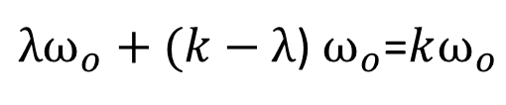
Properties of FS
6. Multiplication
$$x\left(t\right)↔ak$$
$$y\left(t\right)↔bk$$
If & then
$\sum_{λ}{a_{λ}b_{k−λ}}$= $a_{k}{∗b}_{k}$
$$x(t)y\left(t\right)↔$$
Proof:
$x\left(t\right)y\left(t\right)=\sum_{λ}{a_{λ}e^{jλω_{o}t}\sum_{l}{b_{l}e^{jlω_{o}t}}}$=$\sum_{k}{c_{k}e^{jkω_{o}t}}$
$λω_{o}+(k−λ$) $ω_{o}$=$kω_{o}$
$a_{λ}×b_{k−λ}+….$=$c_{k}$
$a_{λ}×b_{k−λ}+a_{λ−1}×b_{k−λ+1}+…$=$c_{k}$
$\sum_{λ}{a_{λ}×b_{k−λ}}$=$c_{k}$

Slide 23
Properties of FS
6. Multiplication
$$x\left(t\right)↔ak$$
$$y\left(t\right)↔bk$$
If & then
$x(t)y\left(t\right)↔\sum_{λ}{a_{λ}b_{k−λ}}$= $a_{k}{∗b}_{k}$
Multiplication in time domain leads to convolution in frequency domain

Slide 24
Properties of FS
7. Parseval’s theorem
$$x\left(t\right)↔ak$$
$$\frac{1}{T}\int_{T}{{\left|x(t)\right|}^{2}}dt=\sum_{k}{{\left|a_{k}\right|}^{2}}$$

Slide 25

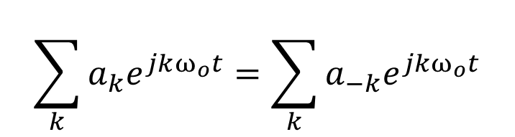


One more issue
$$x\left(t\right)↔ak$$
$$x\left(−t\right)↔a_{−k}$$
$$x\left(t\right)=x(−t)$$
If
$$\sum_{k}{a_{k}e^{jkω_{o}t}}=\sum_{k}{a_{−k}e^{jkω_{o}t}}$$
Can $\sum_{k}{a_{k}e^{jkω_{o}t}=\sum_{k}{{a_}_{k}e^{jkω_{o}t}}}$ without $a_{k}=a_{−k}$ ?

Slide 26
Signals as Vectors

Slide 27
Outline
Introduction to vectors
Introduction to inner product and projection theorem
Introduction to signals as vectors

Slide 28
Outline
Introduction to vectors
Introduction to inner product and projection theorem
Introduction to signals as vectors

Slide 29
Vector Spaces
2D vector
v + u
(x,y)
u
v

Slide 30
Vector Spaces
2D vector
αv
v

Slide 31
Vector Spaces
3D vector
v + u
u
v
(x,y,z)

Slide 32
Vector Spaces
3D vector
αv
v

Slide 33
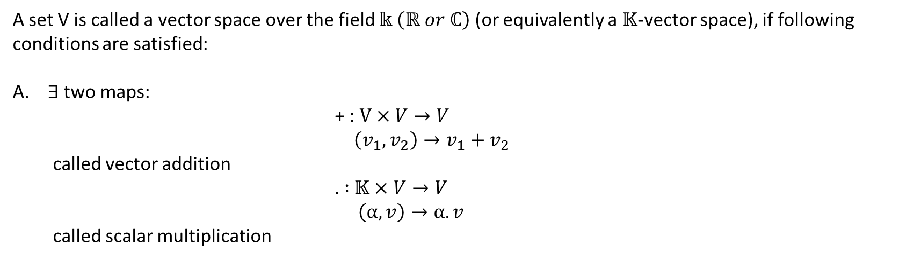
Vector Spaces
A set V is called a vector space over the field $𝕜 \left(ℝ or ℂ\right)$ (or equivalently a $𝕂$-vector space), if following conditions are satisfied:
$∃$ two maps:
                + : $V×V→V$
  $$\left(v_{1},v_{2}\right)→v_{1}+v_{2}$$
  called vector addition
                $.$ $:$ $𝕂×V→V$
                $\left(α,v\right)→α.v$
  called scalar multiplication

Slide 34
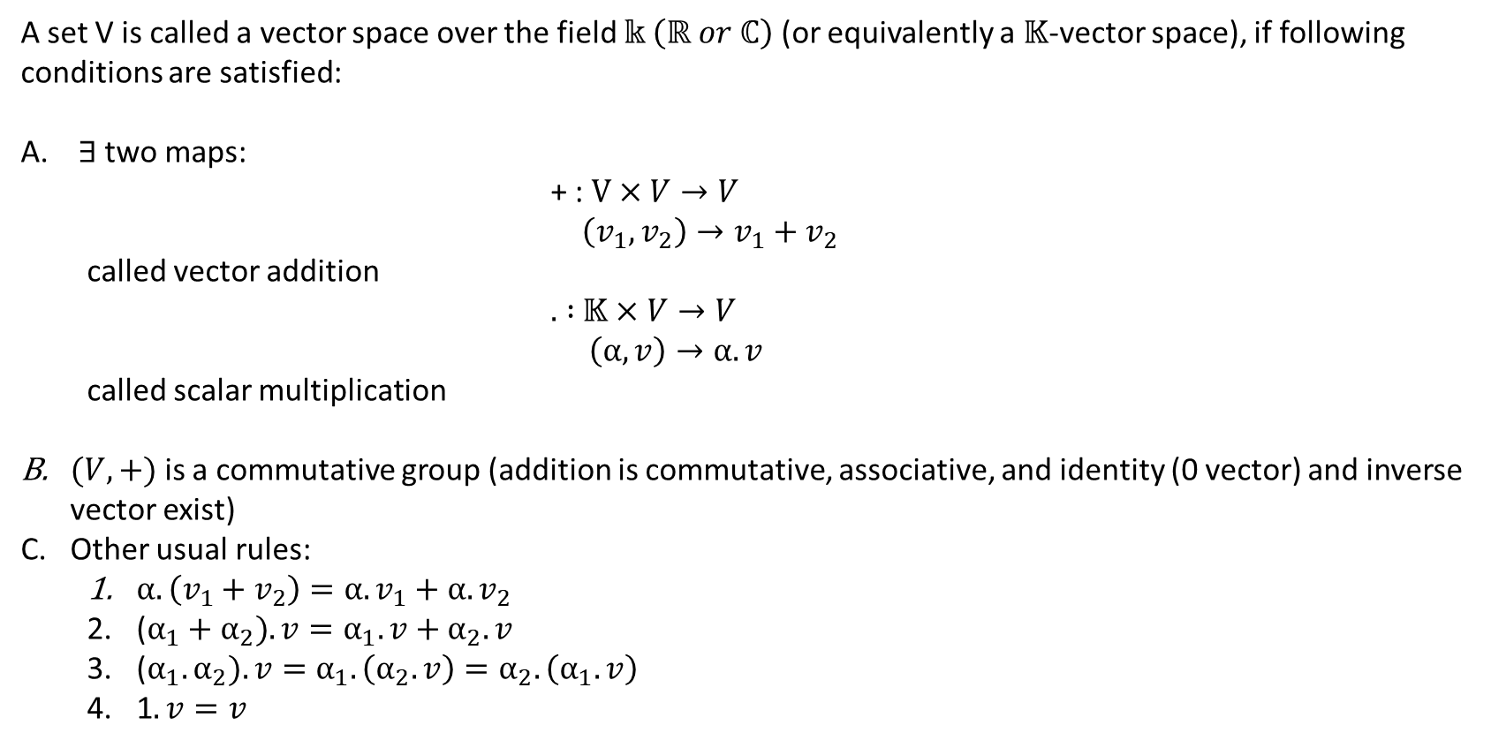
Vector Spaces
A set V is called a vector space over the field $𝕜 \left(ℝ or ℂ\right)$ (or equivalently a $𝕂$-vector space), if following conditions are satisfied:
$∃$ two maps:
                + : $V×V→V$
  $$\left(v_{1},v_{2}\right)→v_{1}+v_{2}$$
  called vector addition
                $.$ $:$ $𝕂×V→V$
                $\left(α,v\right)→α.v$
  called scalar multiplication
$(V,+)$ is a commutative group (addition is commutative, associative, and identity (0 vector) and inverse vector exist)
Other usual rules:
  $α.\left(v_{1}+v_{2}\right)=α.v_{1}+α.v_{2}$
  ($α_{1}+α_{2}). v=α_{1}.v+α_{2}.v$
  ($α_{1}.α_{2}). v=α_{1}.\left(α_{2}.v\right)=α_{2}.\left(α_{1}.v\right)$
  1$.v=v$

